Slide 1
Mastering the Architecture Design Session (ADS)

Slide 2
Abstract and learning objectives
Abstract and learning objectives
Facilitate discussion around top ADS tips & tricks, leading to presentation on what makes a great ADS from requirements collection to architecture.

Slide 3
Basics
An Architecture Design Session (ADS) is a one- to multi-day engagement driven by technical sales that maps technical solutions to customer opportunities.

Slide 4
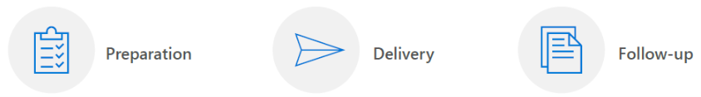
Requirements for success
To successfully lead an ADS, you will need significant time for planning prior to the engagement and for collaboration during the engagement.
In the session, you will identify the opportunity and current state, whiteboard and develop possible solutions for the future state, and propose an implementation plan.
Delivering an ADS is one effective way to land on a shared vision and scope.

Slide 5
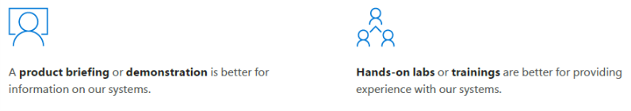
Preparation (1/3)
Initial meeting between the opportunity manager and technical sales (TSP or CSA).
Verify that the collaborative problem-solving approach of an ADS is the best engagement option.

Slide 6
Preparation (2/3)
Planning call with the customer, opportunity manager, and technical sales.
Identify key players for each section of the ADS and prepare a meeting agenda.
Opportunity goals, objectives, and scope
General outline of the existing system
Agenda
Location (not customer site if possible)
Verify that you have the appropriate guest list for the engagement.
Customer attendees (decision makers):
Sponsor, Business representative(s), Project manager
Technical representative(s) (depending on project: Advisors/partners, Architecture, Development, Infrastructure, Operations, Security)
Microsoft attendees
Architect (facilitates session), SMEs (depending on project), Account team

Slide 7
Preparation (3/3)
Develop possible solutions, an implementation plan, and a meeting agenda.
Design
Create a technical solution proposal based on reference architectures.
Plan
Create a phased implementation plan proposal that allows the customer to control cost and schedule impacts.
Participants
Identify key players for each section of the ADS and prepare a meeting agenda.

Slide 8


Sample Agenda
Before the ADS
Preliminary requirements clarification | 9:00 am - 9:30 am
Ideation & Baseline/Candidate Architecture Discussion | 9:30 am - 10:30 am
During the ADS
 | Day 1
Detailed discovery | 9:00 am - 12:00 pm
Envisioning | 1:00 pm - 5:00 pm
 | Day 2
Whiteboard Candidate Architecture(s) | 9:00 am - 12:00 pm
Identify and define POC(s) and Pilot(s) | 1:00 pm – 4:00 pm
Document high level deliverables and next action steps | 4:00 pm – 5:00 pm
This work can be performed remotely.
After the ADS
Create architecture diagrams | *Varies by project
Review architecture diagrams with ADS team | 9:30 am - 10:30 am
The ADS should be performed in-person.
This work can be performed remotely.

Slide 9

Complete the Pre-ADS Checklist
A successful architecture design session relies on preparation. After the ideation, or opportunity definition session, perform the following checklist of items to prepare for the ADS:
Schedule a time for the design session – normally 1-2 days
Schedule a location: ensure you have whiteboards and a projector
Schedule resources: experts from your team, and a cross-cutting panel of technical and business stakeholders from the customer
Build an agenda: establish milestone goals in advance so that the ADS doesn’t get consumed discussing a single topic
Prepare preliminary documentation and architectural diagrams, such as a baseline architecture. Even if you only have the basic building blocks, it’s good to come prepared with something you can modify during or after the session

Slide 10

What are your best practices in preparing for an ADS?

Slide 11
Delivery
Whiteboards and Surface Hub support the type of collaboration you’ll need for a successful ADS.
Focus on your stakeholders, use the whiteboard as a tool for recording ideas, and get approval at each step before moving forward.

Slide 12
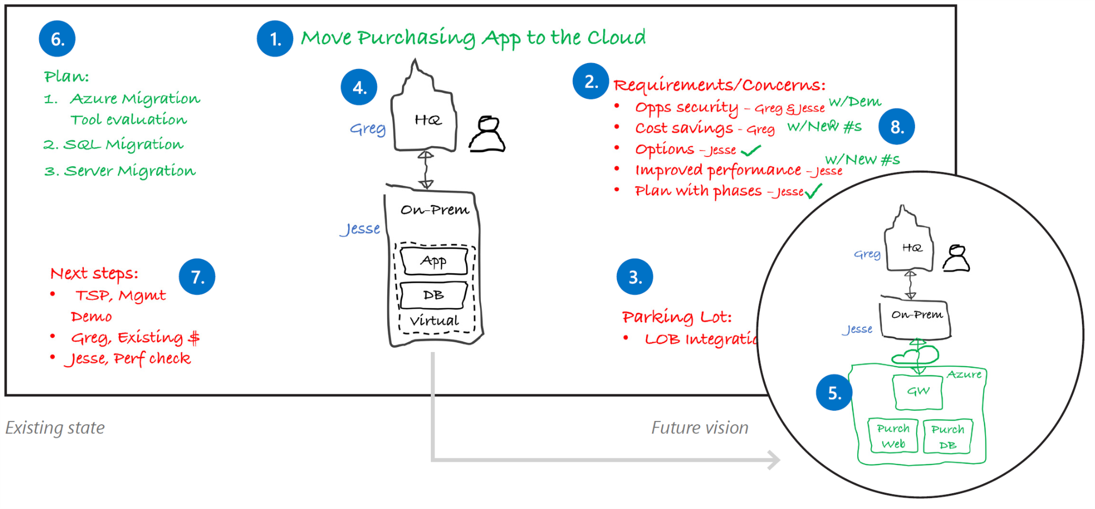
Best practice whiteboard layout
1. Project Goal | 2. Requirements & concerns | 3. Parking lot | 4. Current State | 5. Future Vision | 6. Implementation plan | 7. Next steps | 8. Wrap-up
Notes:
1. Project goal
Write down the project goal to help focus everyone to the desired outcomes.
2. Requirements and concerns
Begin with the items you’ve listed from the pre-call. Make sure that everyone gets a chance to be heard. Write down names next to each person’s requirements or concerns.
3. Parking lot
Acknowledge out-of-scope items. Help people set these concerns aside for later and focus back on the topic at hand.
4. Current state
Diagram the current state and ownership in black. The customer may help diagram this on the whiteboard. Be careful with technical depth. Focus on the system details that affect the ADS outcomes.
5. Future vision
Capture a high-level view of what the customer really wants in green before diving into technologies. Help customers envision the potential opportunities with Microsoft technologies.
6. Implementation plan
Break the plan into clear steps so the customer can track the project schedule and budget flexibility.
7. Next steps
Assign immediate action items during the meeting.
8. Wrap-up
Verify with all stakeholders that their requirements and concerns have been sufficiently addressed with the solution and plan. Close with agreement on the next steps.

Slide 13


Discovery Checklist
Allow ~3 hours
Work with your group to review and whiteboard customer requirements, using prepared notes and diagrams from the ideation session as a guide. Be sure to do the following:
Ensure customer background & business strategy is understood
Clarify the project background and its drivers/aims
Cover the technology landscape: Do they require a hybrid solution or 100% cloud, what is the current technology competency of the team if they will be maintaining the solution, has the customer proposed technologies they’d like to use
Go over usage scenarios for the solution, from the perspective of their internal and external users
Take down all upfront functional and non-functional requirements

Slide 14

Envisioning Checklist
Allow ~4 hours
Work with your group to brainstorm the solution approach, based on details captured from the discovery and ideation sessions. Be sure to do the following:
Key functionalities and capabilities of the solution to meet functional requirements and goals
Components of the solution (e.g. which app services, data services, client side software, identity services, etc.)
Security considerations (TLS, identity, authorization, etc.)
Compliance considerations (HIPAA, PCI, etc.)
Identify external connections and integration points (APIs, business intelligence)
Map requirements and scenarios to the proposed solution components

Slide 15
Planning Checklist
Allow ~8 hours
Work with your group to establish a plan of action and parameters of deliverables, required resources, milestones, and deciding on POC/pilot opportunities and requirements. Be sure to do the following:
Establish proof points
Identify exclusions, risks, and issues (refine solution functionality)
List project pre-requisites (legal, funding, technical, etc.)
List required resources
Notate long-term project plans (continued maintenance, training, handover to customer’s technical staff)
Establish parameters of communication (primary POCs, preferred means of communication, frequency of meetings, whether conducted in person or virtually, and how often)
Identify candidates for a POC/prototype
Identify an opportunity for a pilot
Consider if a POC or pilot is appropriate as the next step
Establish solution deliverables, including for POC or pilot if applicable

Slide 16
Decision Tree – POC or Pilot?
In choosing between implementing a proof of concept or a pilot for a given scope, consider the following questions to help you make your decision:
Will proving the scope out earlier derisk the overall project?
yes
no
Is there uncertainty about the recommended technology/architecture?
Start
yes
no
Does it need to release into production?
Is the technology/architecture unfamiliar to the customer?
no
yes
yes
no
Build a Pilot
Build Proof of Concept
Build neither POC or Pilot, deliver as part of solution

Slide 17
What are your best practices for delivering an ADS?

Slide 18
Follow-up documentation
Email the meeting notes and a draft of the vision and scope to the ADS participants.
Include:
Photos of the board(s)
Key decisions made
Document the requirements and concerns, implementation plan, next steps and action items
A formal illustration of the current state and proposed solution in PowerPoint or Visio

Slide 19

After the ADS Checklist
During the ADS, you and your customer planned a high-level architecture and conceptual design for a solution that addresses their organization’s business goals and technical requirements. In addition to a summary of the engagement, you’ll deliver the following:
Summarize the ADS engagement with customer
Create a proposed timeline of solution deliverables, including deliverables for POC or pilot if applicable
Deliver final architecture diagrams for customer to sign off
Document special areas of concern, such as security, compliance, and compatibility
Provide customer with proposed Microsoft and open source/3rd party technologies to be used for the solution, listing any trade-offs amongst differing technology options
Complete deployment plan with specific examples, covering development, staging, and production targets where applicable
Showcase the capabilities of your solution to deliver business value on premises and/or the cloud

Slide 20
What are your best practices when following up after an ADS?

Slide 21
How to structure and execute a POC / prototype

Slide 22

Benefits of creating a POC
A proof of concept is meant to overcome customer objections by demonstrating the solution will solve the problem for which it is designed. Treat a POC as a continuous learning and improvement process for the solution. A rapid execution tempo of the POC helps validate the customer’s requirements, while giving them confidence in your ability to deliver on your promises. A successful POC can serve as evidence that your practice can use for future engagements with your customer or new ones. In fact, many times the output of a POC can be added to your practice’s intellectual property list for demonstrations, or used to accelerate future solutions.
A typical POC undergoes the following phases:
Define scope – scoping typically occurs during an ADS
Execute implementation – create, test, refine, repeat
Conclude – lessons learned, validation, production development begins
A POC is NOT meant to be used as, or modified to become, the production solution. It is meant for rapid prototyping only. A POC can also be used as a loss leader to generate sales opportunities, or effectively as a profit center.

Slide 23
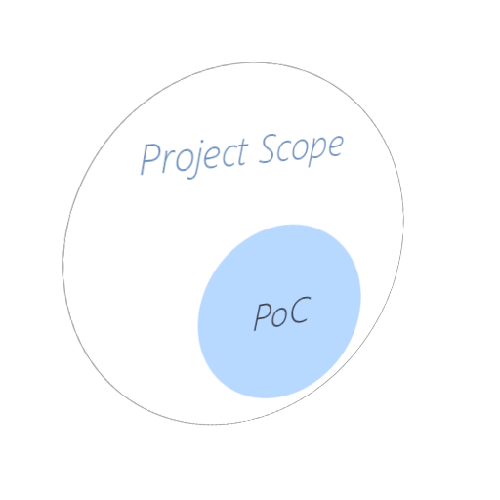
Define POC Scope Checklist
Always establish a clear and concrete scope before starting work on a POC. Work with your group to review and whiteboard POC requirements based on data gathered from the ADS. Be sure to do the following:
Go over established business and technical requirements from the ADS
Condense full set of requirements down to workloads and features of the POC
Select proof points and address objections to overcome
Be able to answer – what are you trying prove with the POC?
Establish team responsibilities and organization
Perform Azure cost estimates
Outline next steps after the success criteria is met
Remember, plan your POC development strategy with speed of execution in mind, not durability and longevity. This is not to become the production solution.

Slide 24

Execute POC Implementation Checklist
Work with your group to draw out the POC architecture, components, technical resources, and success criteria. Be sure to do the following:
List all required technical resources
Identify existing templates that can be used to jump-start POC development, such as ARM templates and Visual Studio project templates
List PaaS services that will be used
Figure out which functionality should be implemented, and which should be stubbed out for reference only
Create a testing plan, both automated and acceptance tests
Discuss how you will involve the customer and/or users in your testing process, to help identify bugs, surface usability issues, and validate business requirements

Slide 25
POC Conclusion Checklist
After your team has met the success criteria of the POC, it is time to move into the next phase of the project. Make certain you clearly outline what went well with the POC, and what should be addressed when planning the production development process. If the POC failed, address the shortcomings and be prepared to conduct a new ADS to work on a new strategy.
Create a report that explains the overall status of the POC and any issues identified during the execution phase
Explain the value proposition of moving forward with a real implementation
Stress to stakeholders that a POC should ot be used in production
Upon agreeing to move to the production phase, create a plan to implement learnings from the POC, delivery schedule, and the cost of the production solution

